Slide 1
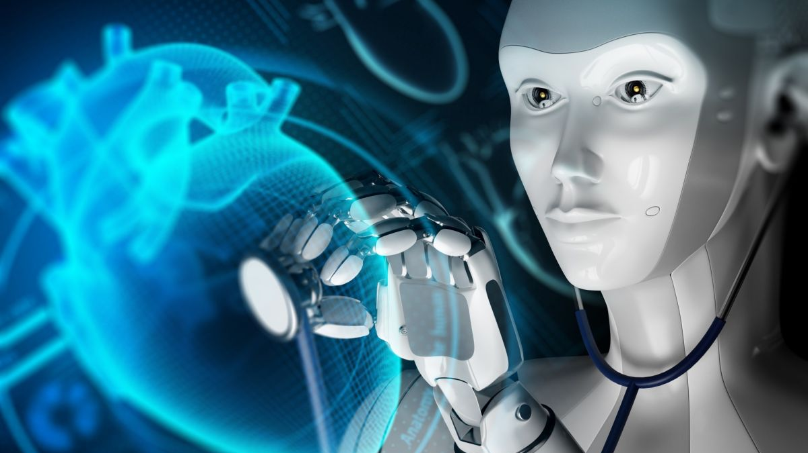
Disease Prediction Using Machine Learning

Slide 2
Team Members:
Venkata Mallikharjuna Rao Pola
Lohith Vamsi Bellamkonda
Venkata Rami Reddy Yarram
Narasimha Raj Kumar Madasu
Arun Sairam Nuvvula

Slide 3
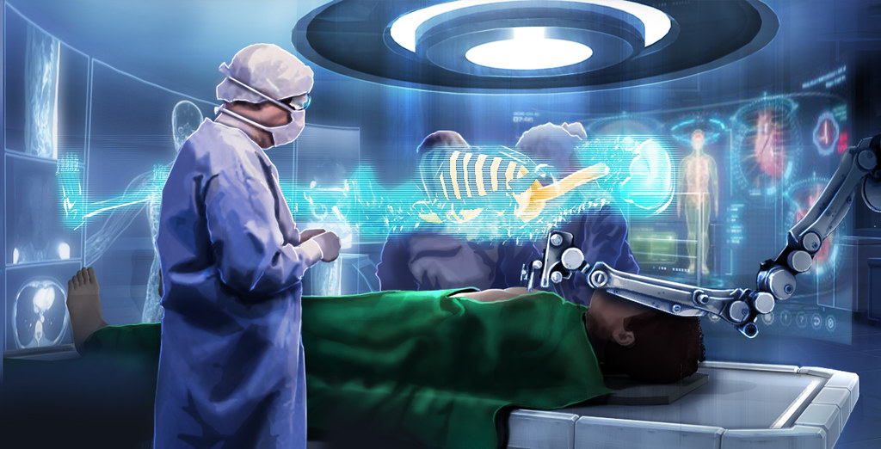
Content:
Motivation
Problem Definition
Proposed Solution
App Features
App UI
Demo
Future Enhancements
Conclusion

Slide 4
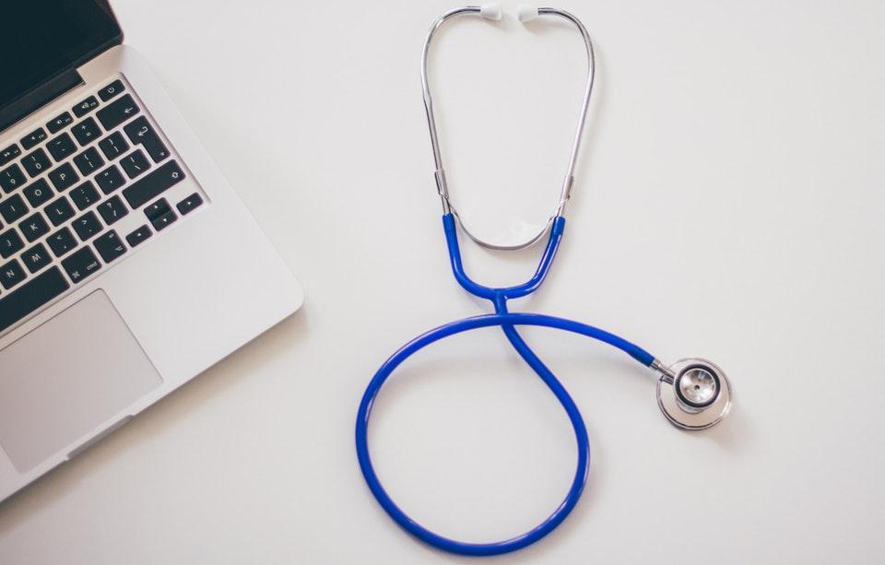
Motivation
Our project aims to revolutionize disease prediction using machine learning, enhancing early diagnosis and patient care.
Focused on heart disease and lung cancer, skin cancer, and brain diseases. we employ advanced algorithms tailored to each disease's complexity.
By using data and advanced methods, we want to help doctors and improve how patients feel.
We aim to give healthcare professionals the tools they need for better care, leading to positive results for patients.

Slide 5
Problem Definition
Our project is dedicated to revolutionizing healthcare by harnessing the power of machine learning for precise disease prediction.
The application targets a range of conditions including heart, lung, skin, and brain diseases, offering users personalized health insights tailored to their specific needs.
Through the utilization of data-driven models, we confront the significant challenge of early disease detection, providing an opportunity for proactive intervention and treatment.
Our overarching goal is to empower individuals to take charge of their health by equipping them with the tools and information necessary to manage their well-being effectively, thereby leading to improved health outcomes.

Slide 6
Proposed Solution
Introducing a comprehensive healthcare solution leveraging machine learning to predict heart, lung, skin, and brain diseases.
Our innovative Android app utilizes advanced algorithms like Random Forest for heart disease, Convolutional Neural Networks for lung cancer, and tailored models for skin and brain diseases.
With user-friendly interfaces, real-time predictions, and continuous improvement, our app aims to revolutionize early diagnosis and improve patient outcomes.

Slide 7
App Features
1. Multi-Disease Prediction:
- Predict the risk of heart, lung, skin, and brain diseases in a single app.
2. User-Friendly Interface:
- Design an easy-to-use interface for seamless data input and result interpretation.
3. Real-Time Predictions:
- Provide instant health predictions based on user-inputted data.
4. Interpretability:
- predictions in simple terms for user understanding.
5. Privacy and Security:
- Ensure robust measures to protect user data and comply with healthcare regulations.
6. User Profiles:
- Enable users to create profiles for personalized tracking and recommendations.

Slide 8
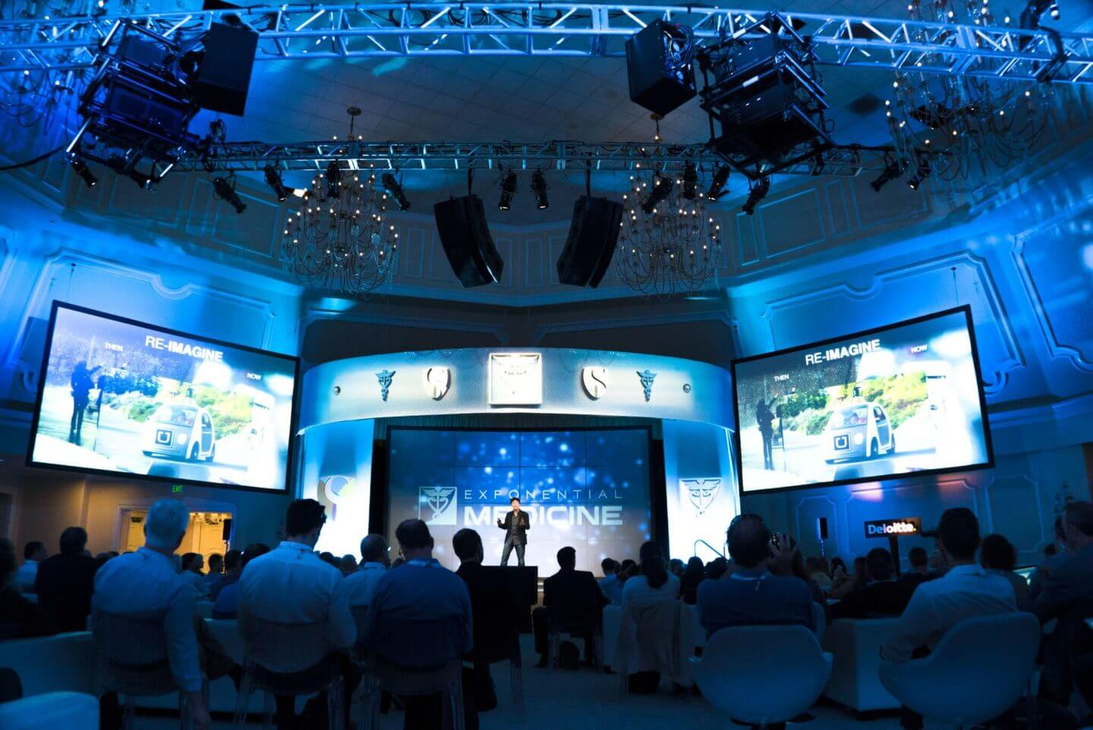
DEMO

Slide 9
Future Enhancements
1. Interactive Health Tips:
- Develop an interactive feature providing users with actionable health tips based on their predictions, promoting healthier lifestyle choices.
2. Expanded Disease Coverage:
- Include predictions for additional diseases, broadening the app's utility and addressing a wider range of user health concerns.
3. Enhanced Data Visualization:
- Improve visual representations of health data, making it easier for users to understand and monitor their health trends over time.
4. Integration with Fitness Apps:
- Collaborate with popular fitness apps to integrate exercise and nutrition data, offering a holistic view of users' health behaviors.
5. Localized Health Resources:
- Provide region-specific health resources and recommendations, tailoring the app's content to the unique healthcare needs of different user populations.knowledge and advancements.

Slide 10
Conclusion
Our health prediction app is user-friendly and predicts risks for heart, lung, skin, and brain diseases, simplifying health management.
Instant results ensure quick access to health insights.
Privacy assurance is paramount, guaranteeing the confidentiality of user data.
Continuous improvements are underway to enhance the app's functionality and accuracy.
Our aim is to offer a straightforward and accessible tool for personalized health insights.
By addressing predictions for heart, brain, and lung diseases, we've laid a solid foundation.
We are actively integrating skin disease prediction into our app, completing our comprehensive approach to health monitoring and management.

Slide 11


